Slide 1

Department of Computer Science and Engineering TITLE: AUTOMATIC DETECTION OF DIABETIC RETINOPATHY USING CNN
VISVESVARAYA TECHNOLOGICAL UNIVERSITY - BELAGAVI
Accredited by NBA
Students Name:
Ms. Bharti. S. Khoth (2BU22CS034)
Ms. Bhuvaneshwari. M (2BU22CS038)
Mr. Karthik. Katti (2BU22CS054)
Mr. Kishan. Miskin (2BU23CS404)
Guide Name:
Name: Kshitij Sheth
Designation: Asst Professor

Slide 2
Content
Introduction
Problem Statement
Objectives
Requirement Specification
Block Diagram
Methodology
Proposed Architecture Diagram
Algorithm
Conclusion and Future Enhancement
Results
References

Slide 3
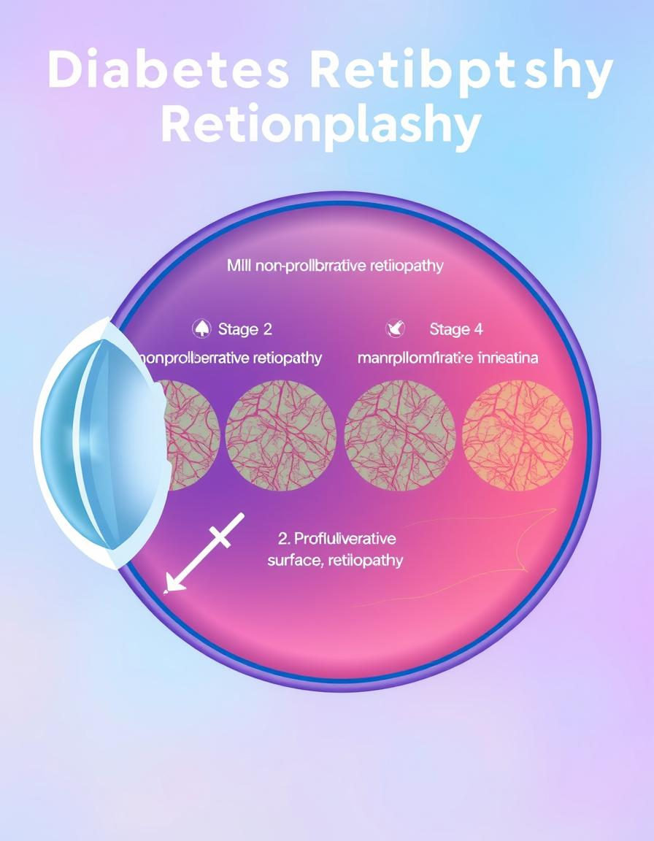
INTRODUCTION
Diabetic Retinopathy(DR) is a complication of diabetes, caused by high blood sugar levels damaging the back of the eye (retina). Early diagnosis is to ensure that patients with diabetes are not affected by blindness.
Deep learning plays an important role in the diagnosing Of the diabetes. This project demonstrates the use of Convolutional Neural Networks CNN on color fundus images to recognize the staging of diabetic Retinopathy. The CNN classifies the images into different severity levels—such as positive, negative, moderate, diabetic retinopathy

Slide 4
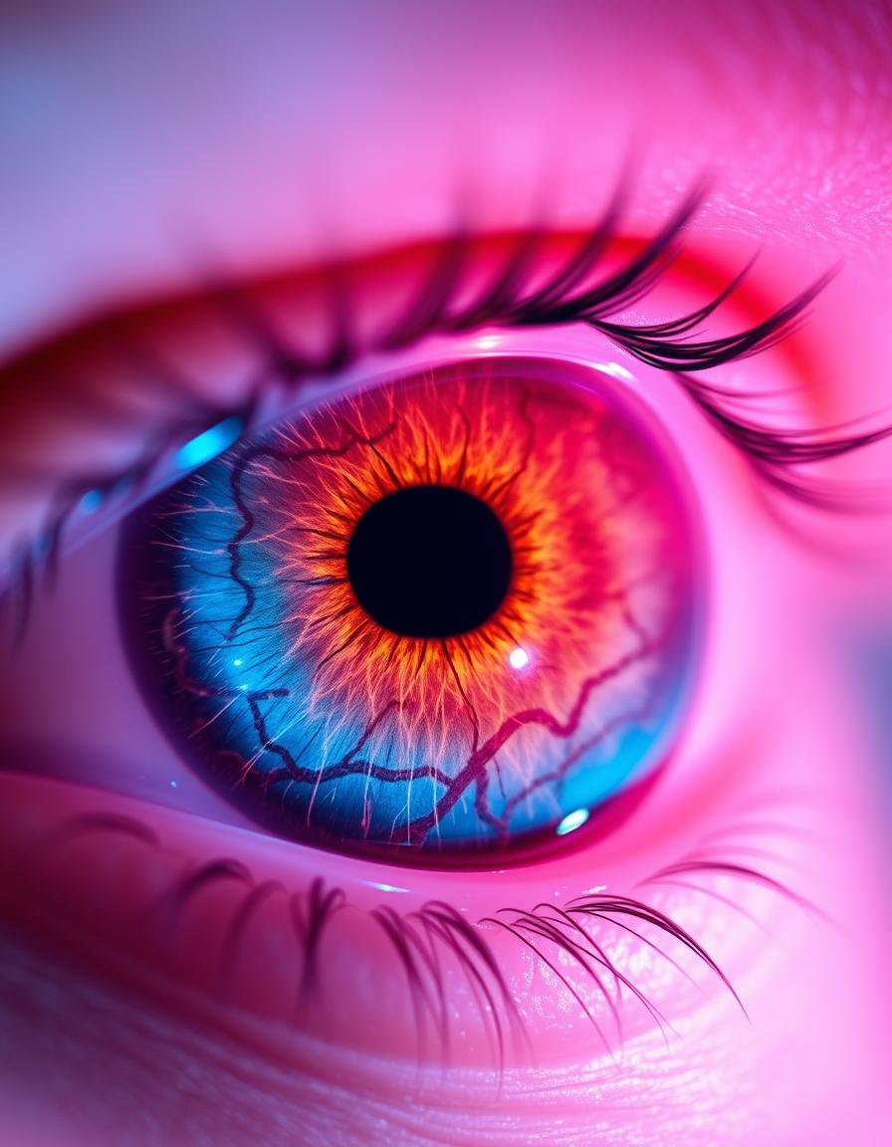
Problem statement
.
Diabetic Retinopathy is a condition that can cause blindness if not detected early. The goal is to create a system that can automatically detect this condition from eye images, This can reduce vision loss, improve patient care.

Slide 5
OBJECTIVES
Design and implement a Convolutional Neural Network that can identify Diabetic Retinopathy from retinal images.
Ensure consistent and accurate classification of retinal images as either healthy or affected by Diabetic Retinopathy.
Design a user-friendly system that allows users to upload retinal images easily.
It Helps improve early diagnosis of diabetic retinopathy, helping in the prevention of severe vision loss.
The System implement effective image preprocessing techniques to enhance retinal image quality and improve model accuracy.

Slide 6
REQUIREMENT SPECIFICATION
Programming Language
Python :- Implements CNN algorithm
2. Convolution Neural Network (CNN) model :- which extracts retinal features through convolution and pooling layers and accurately classifies diabetic retinopathy.
3. Libraries and Tools :
OpenCV :- OpenCV is used for image processing operations before feeding images to the CNN model.
Keras :- Provides an easy-to-use interface for building and training CNN Models
TensorFlow :- is used as the core deep learning framework that runs the CNN model
Numpy :- is used for numerical operations and array manipulation.
Pandas :- Pandas is used for data handling and analysis, especially during model evaluation.
HTML & CSS :- HTML is used to design the structure of the web-based user interface, CSS is used to enhance the visual appearance of the web application.

Slide 7
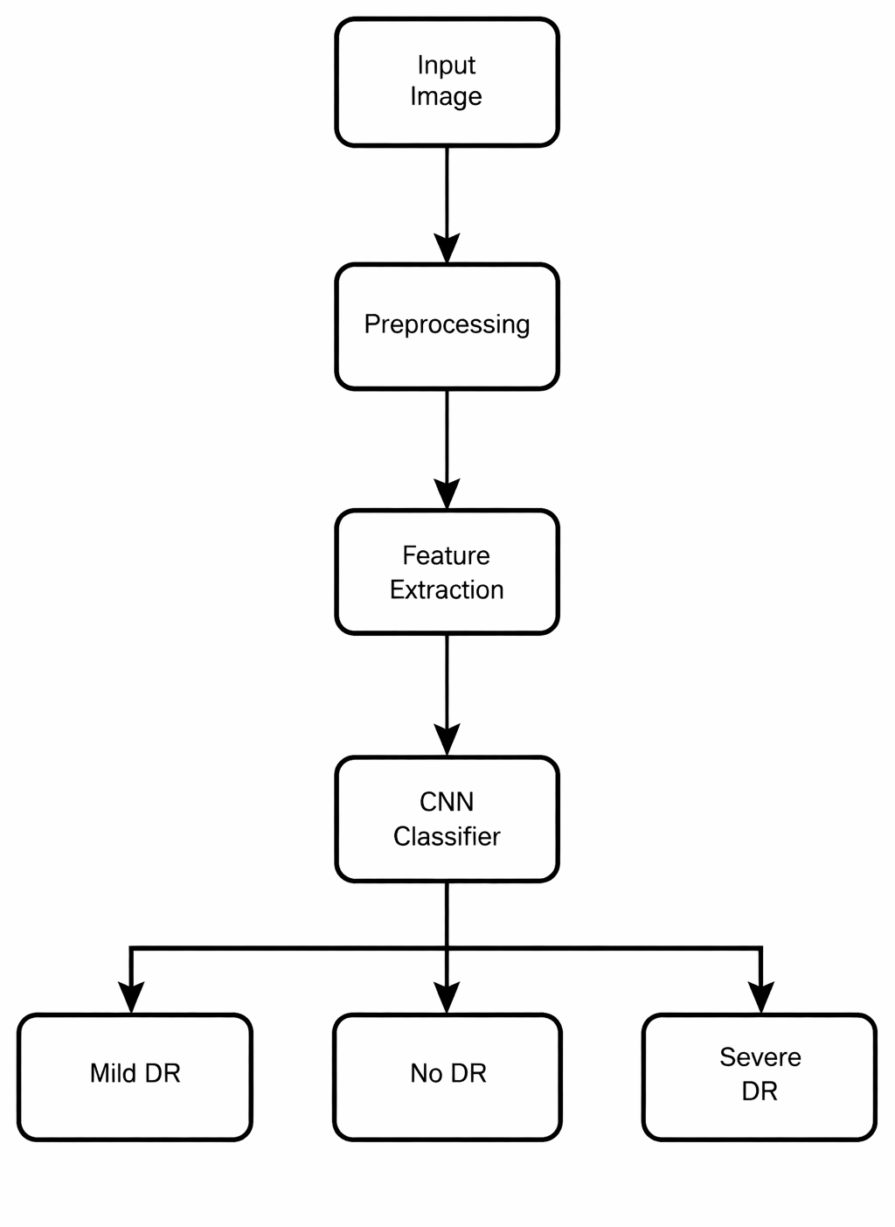
Block Diagram

Slide 8
METHODOLOGY
1. Image Collection
Retinal fundus images are collected from available sources and stored in local system folders, all images are accessed directly from the file system.
2. Image Preprocessing
Each retinal image is preprocessed to improve quality and consistency, This includes resizing the images to a fixed dimension, noise removal.
3. Data Splitting
The dataset is divided into training and testing sets using a predefined ratio The split is performed directly on image folders.

Slide 9
4. CNN Model Construction
A Convolutional Neural Network is designed using multiple convolutional, pooling, and activation layers. The CNN automatically extracts important features from retinal images that are relevant for diabetic retinopathy detection.
5. Model Training
The CNN model is trained using the training image set. During training, weights are optimized using backpropagation and an appropriate optimizer.
6. Model Evaluation
The trained model is evaluated using the test image set. Performance is measured using accuracy to give the effectiveness of the detection system.

Slide 10
7. Prediction and Classification
For prediction, a retinal image is uploaded or selected from a local folder. The image is preprocessed and passed through the trained CNN model, which classifies it as Normal, Mild, or Diabetic Retinopathy.
8. Result Display
The Prediction result is displayed through the console with the Accuracy of Diabetics as a Positive or Negative

Slide 11
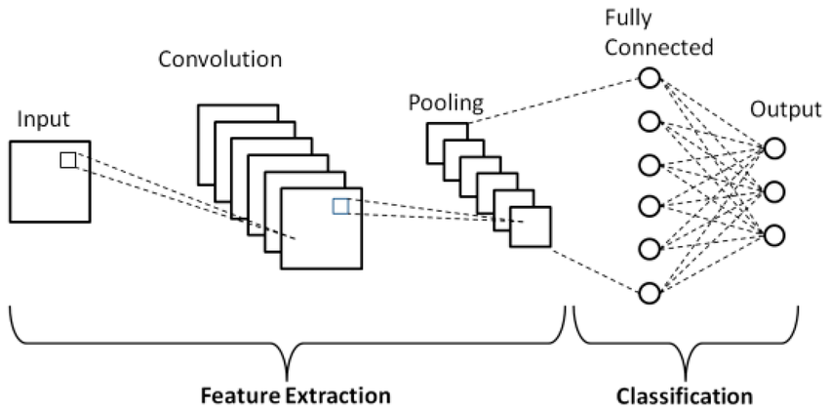
SYSTEM LEVEL DIAGRAM
Figure :- The System level Diagram

Slide 12
Input Image Retinal image is taken as input and resized to a fixed size. Each pixel value represents the raw data that the CNN will analyze.
Pre-processing Image is normalized to improve quality and remove noise. Filters slide over the image to detect low-level features
Convolution CNN scans the image using filters to find important features such as blood vessels and lesions.
Activation Layer Removes unnecessary values and keeps useful information. which combine the features to make predictions.
Pooling Reduces image size while keeping important features.

Slide 13
Repeat CNN Layers again it repeates 3–5 times to learn deeper patterns.
Fully Connected Layer Learns the difference between normal and affected images. It will helps classify the Results
Output Layer Gives final result: Positive or
Negative Diabetic Retinopathy

Slide 14
ALGORITHM
Step 1: Start
Initialize the system and load the required Python libraries.
Step 2: Load Dataset
Load retinal fundus images directly from local folders.
Step 3: Image Preprocessing
Resize image to standard dimensions
Remove noise and enhance contrast
Step 4: Split Dataset
Divide images into training and testing sets.
Step 5: Build CNN Model
Convolution layers

Slide 15
Activation function
Max pooling layers
Fully connected layers
Step 6: Train Model
Train the CNN model using training images and corresponding labels.
Step 8: Test Model
Evaluate the model using test images.
Step 9: Performance Evaluation
Accuracy and percentage
Step 10: Classification
Normal or Diabetic Retinopathy
Step 11: Display Result
Display the prediction output to the console

Slide 16
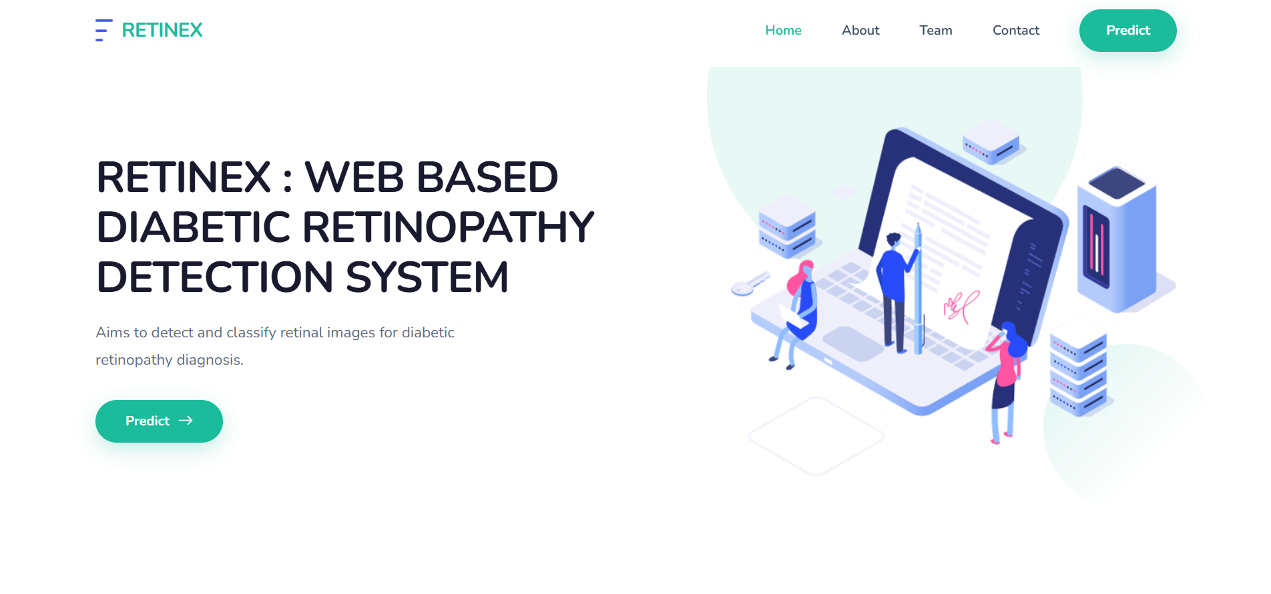
RESULT

Slide 17
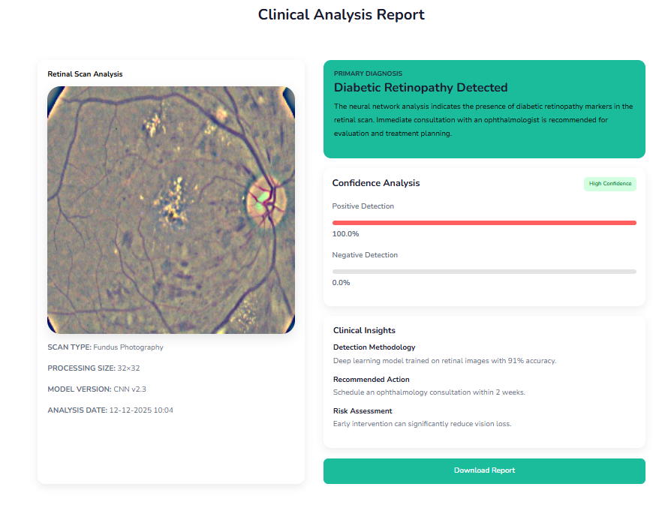
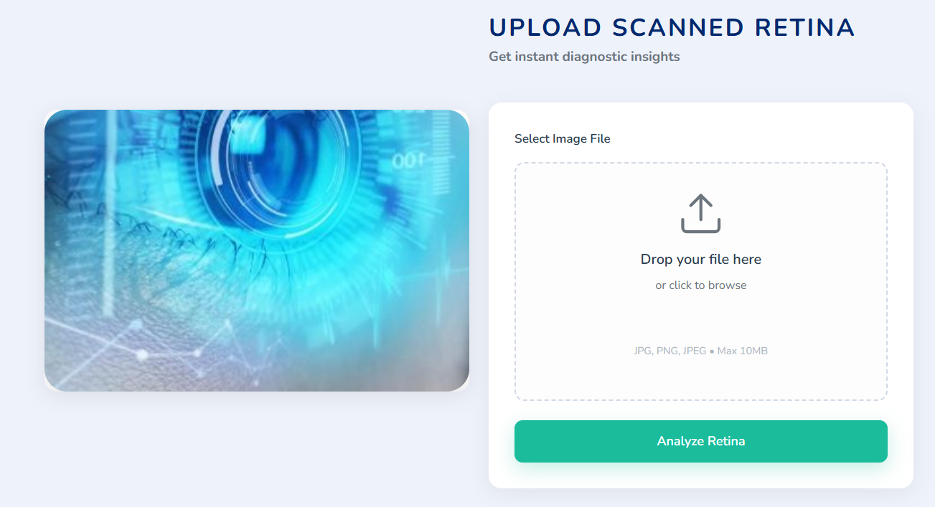

Slide 18
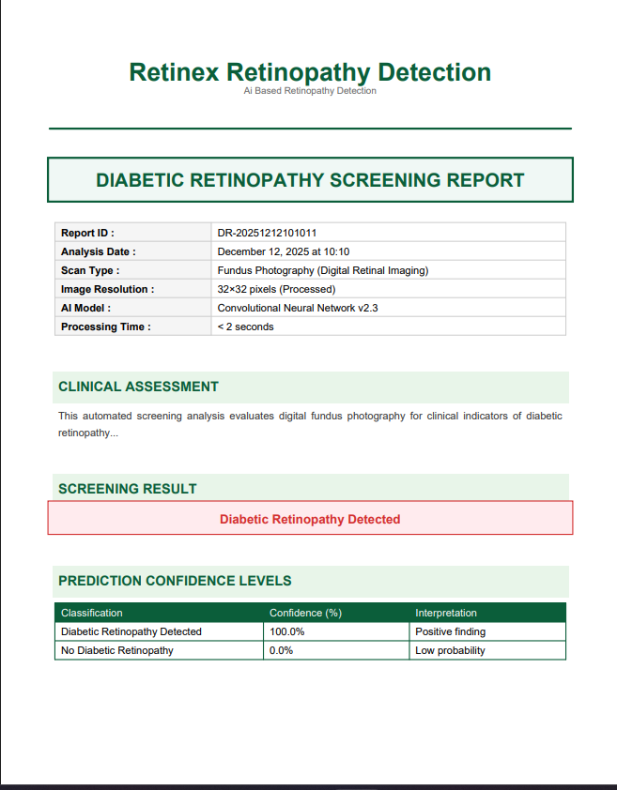
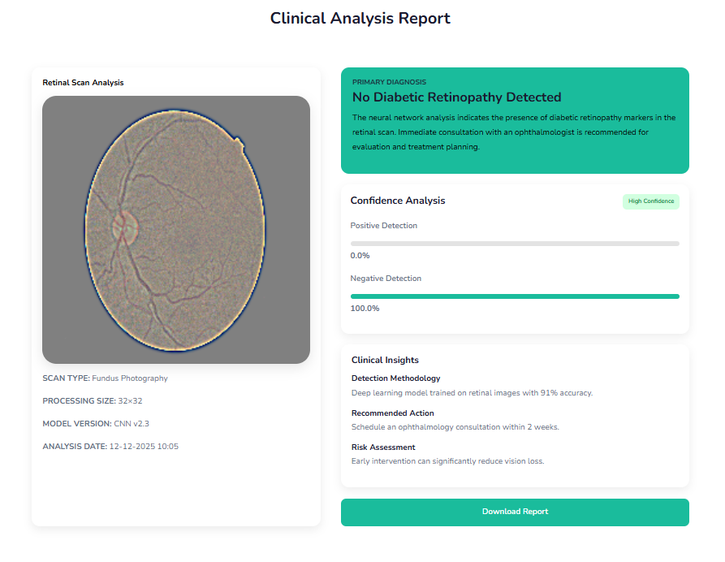

Slide 19
Conclusion and Future Enhancement
Conclusion:
CNN-based models effectively detect diabetic retinopathy from retinal images, fast and accurate diagnosis support. This reduces dependency on specialists and promotes early detection, crucial for preventing vision loss.
Future Enhancements:
Use larger, diverse datasets for better accuracy
Add explainable AI tools for model transparency
Extend to detect multiple eye diseases
Develop mobile-friendly,
Enable cloud-based remote screening and diagnosis

Slide 20
REFERENCES
[1]. Gulshan, V., Peng, L., Coram, M., et al., “Development and Validation of a Deep Learning Algorithm for Detection of Diabetic Retinopathy in Retinal Fundus Photographs,” Journal of the American Medical Association (JAMA), Vol. 316, No. 22, pp. 2402–2410, 2016.
[2]. Pratt, H., Coenen, F., Broadbent, D. M., Harding, S. P., and Zheng, Y., “Convolutional Neural Networks for Diabetic Retinopathy,” Procedia Computer Science, Vol. 90, pp. 200–205, 2016.
[3]. Lam, C., Yu, C., Huang, L., and Rubin, D., “Retinal Lesion Detection With Deep Learning Using Image Patches,” Investigative Ophthalmology & Visual Science, Vol. 59, No. 1, pp. 590-596, 2018

Slide 21
THANK YOU

